Slide 1
Team Nevermind
Evaluating Environmental Impact

Slide 2
Hypothesis: Demographic growth and economic growth generate environmental impact
We will check the hypothesis by looking at data by country, by year, from 1960 to 2013, with datasets for: Demographic Growth, Gross Domestic Product, CO2 and Temperature (and Climate Change)

Slide 3

User input
We included data from 193 countries. The user can choose which country they would like to compare. We offer two ways in which the user can input information.

Slide 4

Code

Slide 5
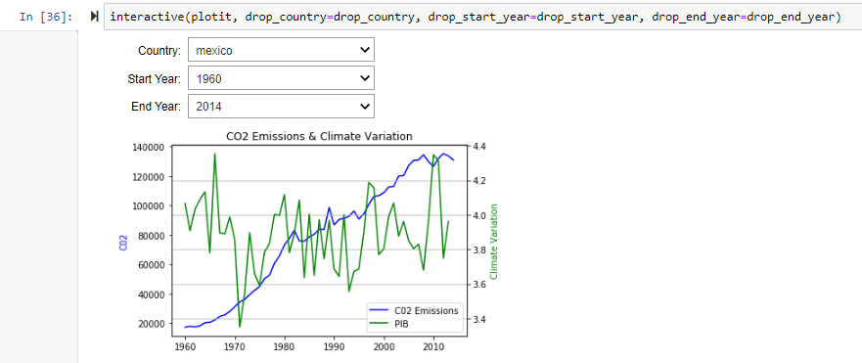
Code

Slide 6
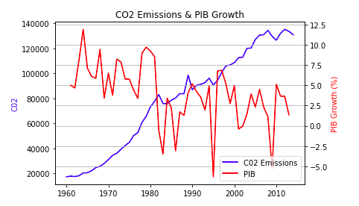
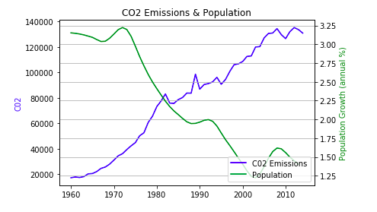
Which variable (Demography or GDP) has the greatest environmental impact (CO2 or Temperature)?
Notes:
Comentario -- Poblacion es crecimiento, no total.

Slide 7
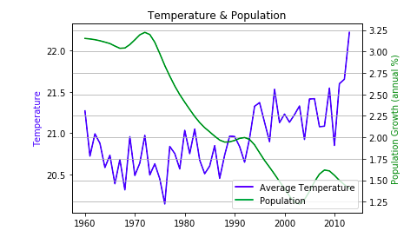
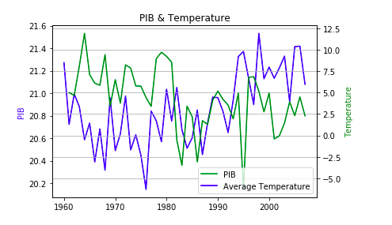
Which variable (Demography or GDP) has the greatest environmental impact (CO2 or Temperature)?
Answer: The GDP variable is the best to visualize environmental impact.

Slide 8
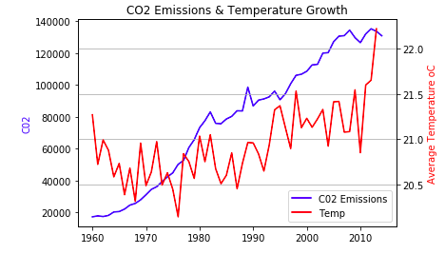
Follow-up questions: Are CO2 emission and temperature correlated?
Answer: Yes, the emission of CO2 and the temperature correlates. Correlation is not causality, but they are variables recognized by scientists as causal.

Slide 9
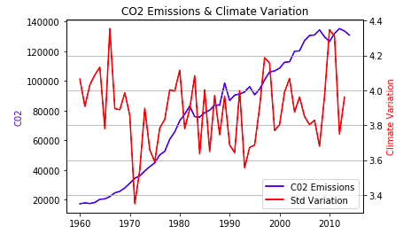
Follow-up: Are CO2 emissions and Climate Change correlated?
Answer: We assume that standard deviation is a proxy for climate change. And, yes, the emission of CO2 and Climate Change correlates, somewhat. The greater the change in standard deviation from year to year, the greater the climate change, which correlates with temperature. The exception is 1965.

Slide 10
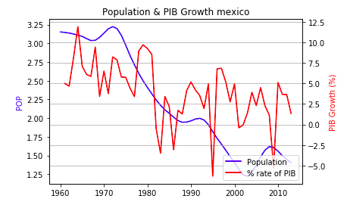
Follow-up questions: Are GDP and Demographic Growth correlated?
Answer: No. The percentage of population growth decreases while the GDP fluctuates irregularly and does not coincide with the demographic decline.

Slide 11
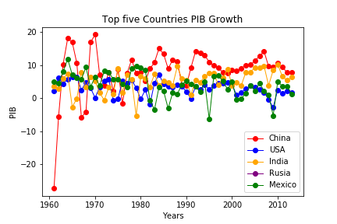
Future Projections
We decided to create future projections for the 4 countries with the highest GDP in 2013 + Mexico.

Slide 12
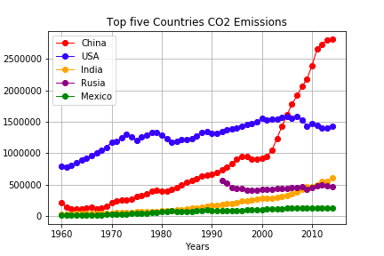
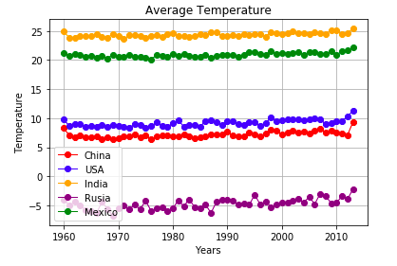
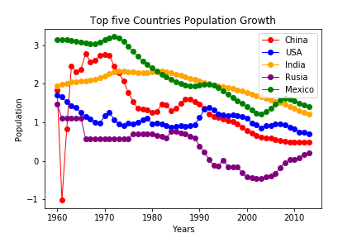
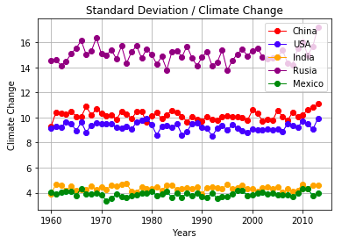
China's CO2 Emissions has increased with its GDP; not so for the United States or Russia
Russia's population is growing %-wise. It also has the most variation in Climate Change

Slide 13
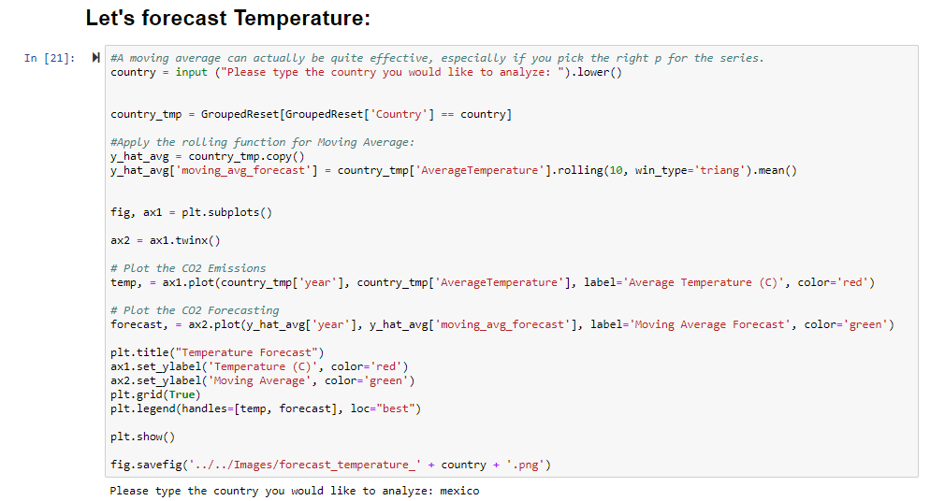
Temperature Forecast

Slide 14
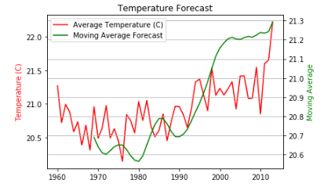
Temperature Forecast

Slide 15
Conclusions
GDP is the economic/demographic variable that most closely correlates with environmental impact
It would have been best to analyze total population, rather than percentage of demographic growth.
CO2 emissions and temperature correlate well. Climate Change does not correlate as well with CO2 emissions
GDP and % of demographic growth does not correlate as well.

